Slide 1
A Faster and Simpler Algorithm for Sorting Signed Permutation by Reversals
Haim Kaplan, Ron Shamir and Robert E. Tarjan, SIAM Journal on Computing,
Vol. 29, No. 3, 2000, pp. 880-892.
Advisor: Prof. C. B. Yang
Speaker: Liang-Tai Wei
Date: June 30, 2004

Slide 2
Abstract
We give a quadratic-time algorithm for finding the minimum number of reversals needed to sort a signed permutation. Our algorithm is faster than the previous algorithm of Hannenhalli and Pevzner and its faster implementation of Berman and Hannenhalli. The algorithm is conceptually simple and does not require special data structures. Our study also considerably simplifies the combinatorial structures used by the analysis.

Slide 3
The Problem
Sorting signed permutations by reversals.
A reversal, ρ(i,j) , on π to
π′ = πρ(i,j) =
(π1 ,..., πi-1, -πj, ..., -πi, πj+1, ..., πn).
The problem of sorting signed permutations by reversals is to find, for a given signed permutation π, a sequence of reversals of minimum length that transforms π to the identity permutation (+1, +2, …, +n).

Slide 4
Unsigned Permutations, Breakpoints
Let π = (π1, ..., πn) denote a permutation of {1, 2, ...n}.
Augment π to a permutation on n + 2 vertices by adding π0 = 0 and πn+1 = n + 1 to it.
A gap is a pair (πi, πi+1), 0 ≤ i ≤ n.
A breakpoint of π is a gap iff |πi - πi+1| > 1;
otherwise it is an adjacency of π.

Slide 5
The Breakpoint Graph
The breakpoint graph B(π) of a permutation π = (π1, ..., πn) is an edge-colored graph on n+2 vertices {π0, π1,..., πn+1} = {0, 1, ..., n+1}. We join vertices πi and πj by black edge if (πi, πj) is a breakpoint in π and by a gray edge if (i, j) is a breakpoint in π⁻¹.

Slide 6
The Breakpoint Graph (contd.)
A one-to-one mapping μ form the set of signed permutations of order n into the set of unsigned permutations of order 2n as follows.
  Replace each positive element x by 2x-1,2x
  Replace each negative element –x by 2x,2x-1
An even reversal is a reversal ρ(i, j) such that i is odd and j even.
The reversal ρ(2i+1, 2j) on ρ mimics the reversal ρ(i+1, j) on π. Thus, sorting π by reversals ⬄ sorting μ (π) by even reversals.
We will consider the latter problem, and by a reversal we will always mean an even reversals.

Slide 7
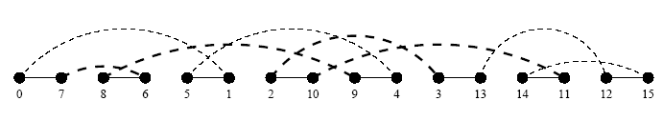
The Breakpoint Graph (contd.)
Example:
π = (4, -3, 1, -5, -2, 7, 6)
μ (π) = (7, 8, 6, 5, 1, 2, 10, 9, 4, 3, 13, 14, 11, 12)
The breakpoint graph, B(π)

Slide 8
The Overlap Graph
The overlap graph of a permutation π, denote OV(π), is the interval overlap graph of the gray edges of B(π).
  The vertex set of OV(π) is the set of gray edges in B(π).
  Two vertices are connected if the intervals associated with their gray edges overlap.

Slide 9
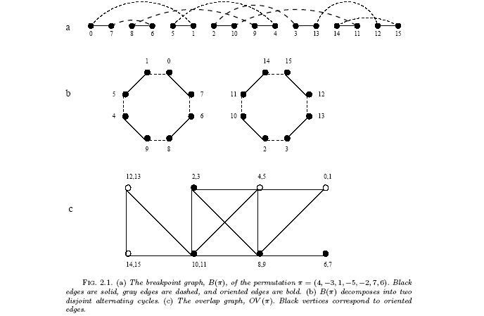
The Overlap Graph (contd.)
Example:

Slide 10
Hurdles
A hurdle is an unoriented connected component such that all of the vertices that are endpoints of its gray edges occur consecutively in the permutation.
We say that a hurdle is simple if deleting it does not create a new hurdle; otherwise we say that it is a super hurdle.
A fortress is a permutation with an odd number of hurdles, all of which are super hurdles.

Slide 11
Theorem
Let b be the number of breakpoints, c be the number of nontrivial cycles, and h the number of hurdles.
Theorem. The inversion distance is d = b –c + h if the diagram is not a fortress, d = b – c + h + 1 otherwise. (Hannenhalli and Pevzner (STOC 1995))

Slide 12
The Algorithm
1. Pre-process the permutation.This pre-processing contains 3 sub stages:
  1a. Unsign the permutation, e.g., p will be unsigned to the permutation 0, (7,8), (4,3), (1,2), (5,6), (12,11), (9,10), 13.
  1b. Define the Overlap graph of the permutation
  1c. Find the connected components of the overlap graph
2. Clear the hurdles. A hurdle is a problematic connected component of the overlap graph. In this stage each reversal merges two hurdles in distinct connected components into one non hurdle component.
3. Generate a sequence of safe reversals. A safe reversal is defined as a reversal that reduces b-c (the number of breakpoints minus the number of cycles) without creating new hurdles.

Slide 13
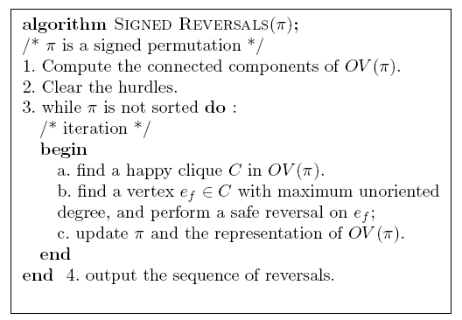
The Algorithm (contd.)

Slide 14






Happy Cliques
Let C be a clique of oriented vertices in OV(π). We say that C is happy if for every oriented vertex and every vertex
such that there exists an
oriented vertex such that and .

Slide 15
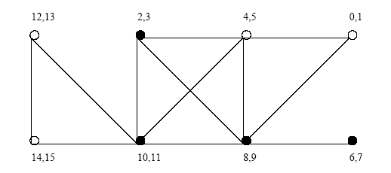
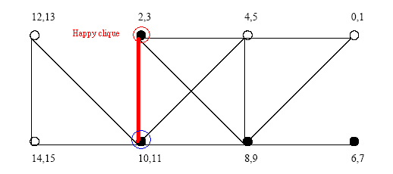
Happy Cliques (contd.)
Example:

Slide 16
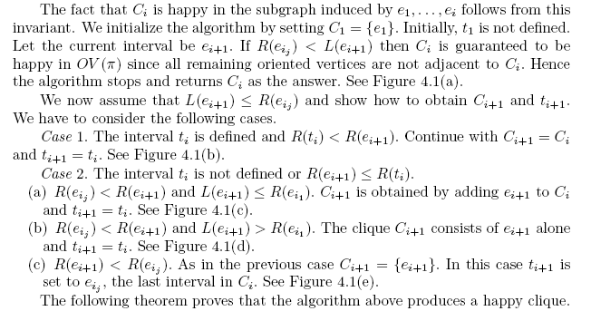
Finding a Happy Clique

Slide 17
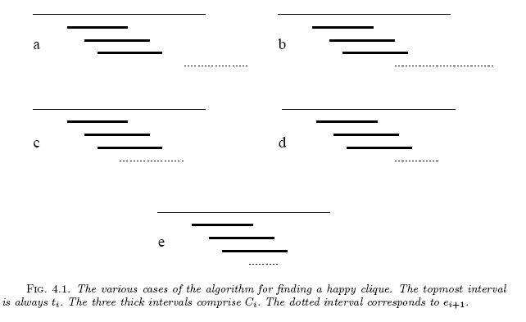
Finding a Happy Clique (contd.)

Slide 18
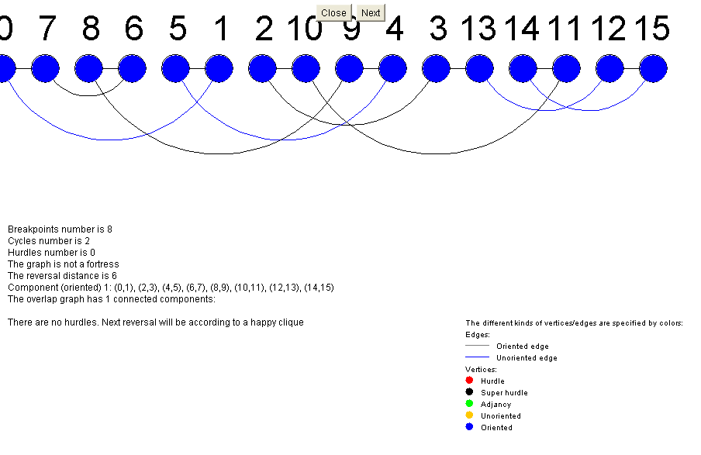
Example

Slide 19
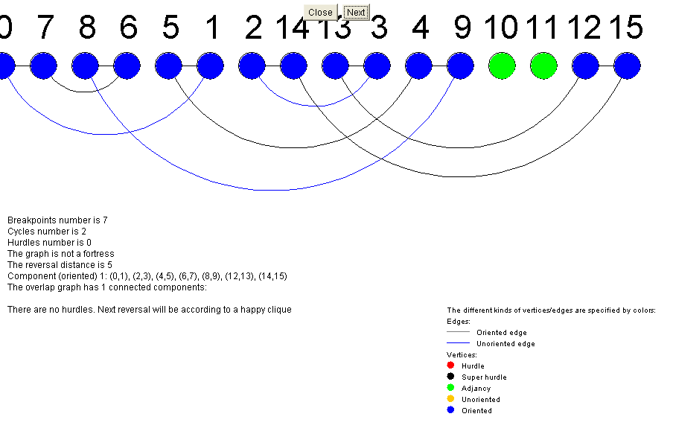
Example (contd.)

Slide 20
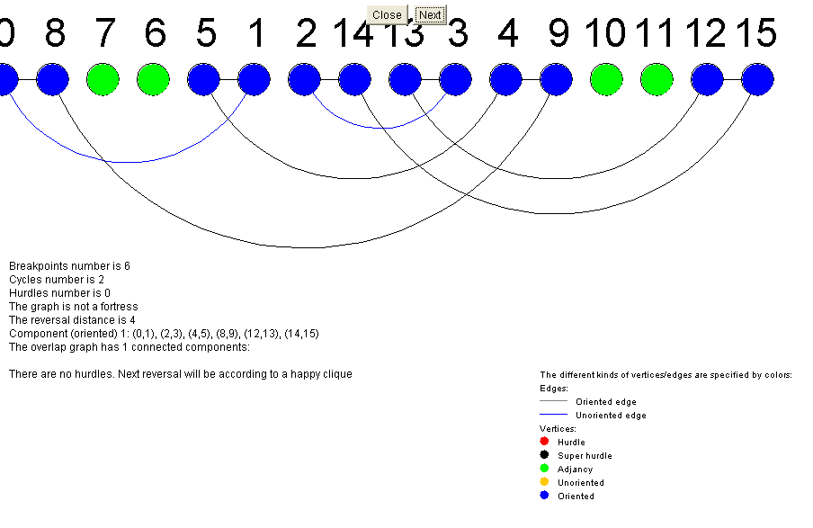
Example (contd.)

Slide 21
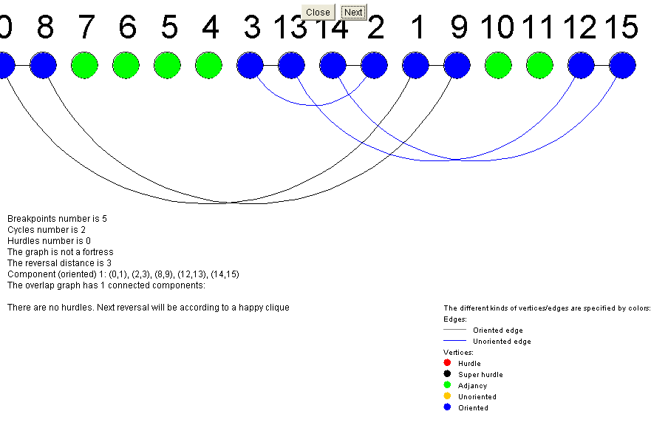
Example (contd.)

Slide 22
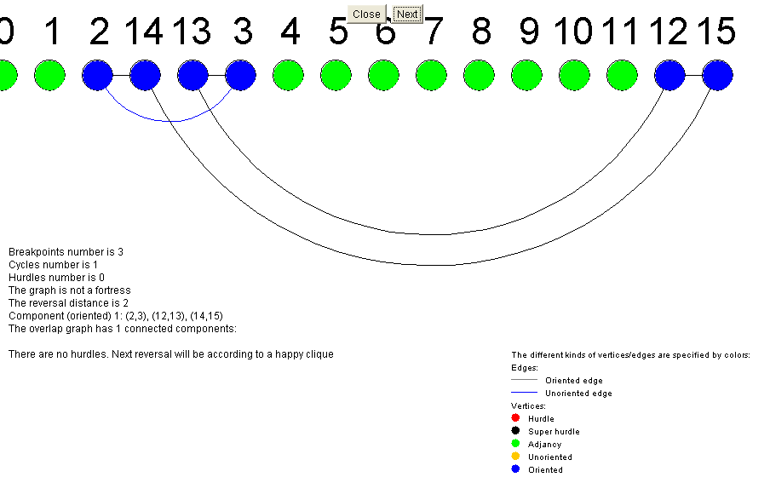
Example (contd.)

Slide 23
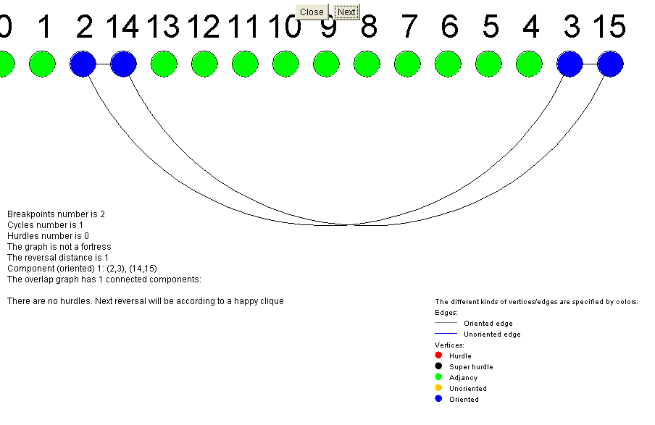
Example (contd.)

Slide 24
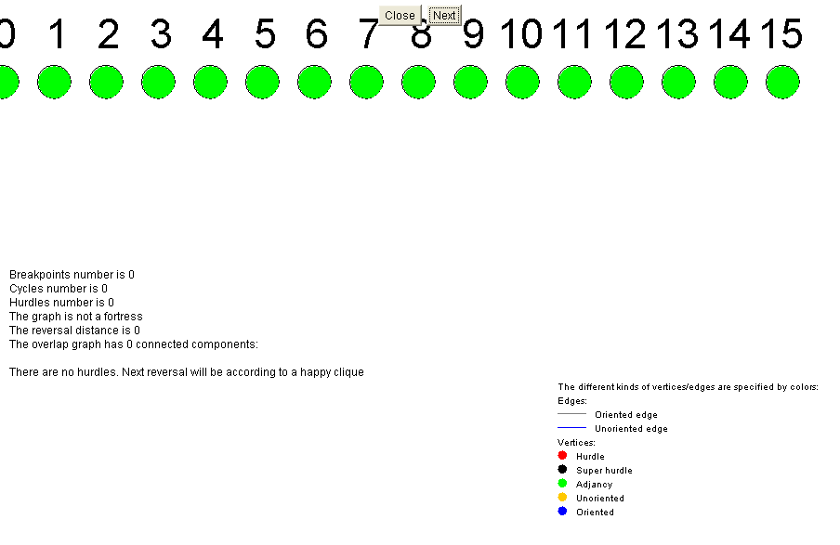
Example (contd.)

Slide 25
Thanks

